Slide 1
CSE 477: Introduction to Computer Security
Lecture – 6
Course Teacher: Dr. Md Sadek Ferdous
Assistant Professor, CSE, SUST
E-mail: ripul.bd@gmail.com

Slide 2
Outline
Crypto primitives
Classis crypto systems
Block cipher

Slide 3
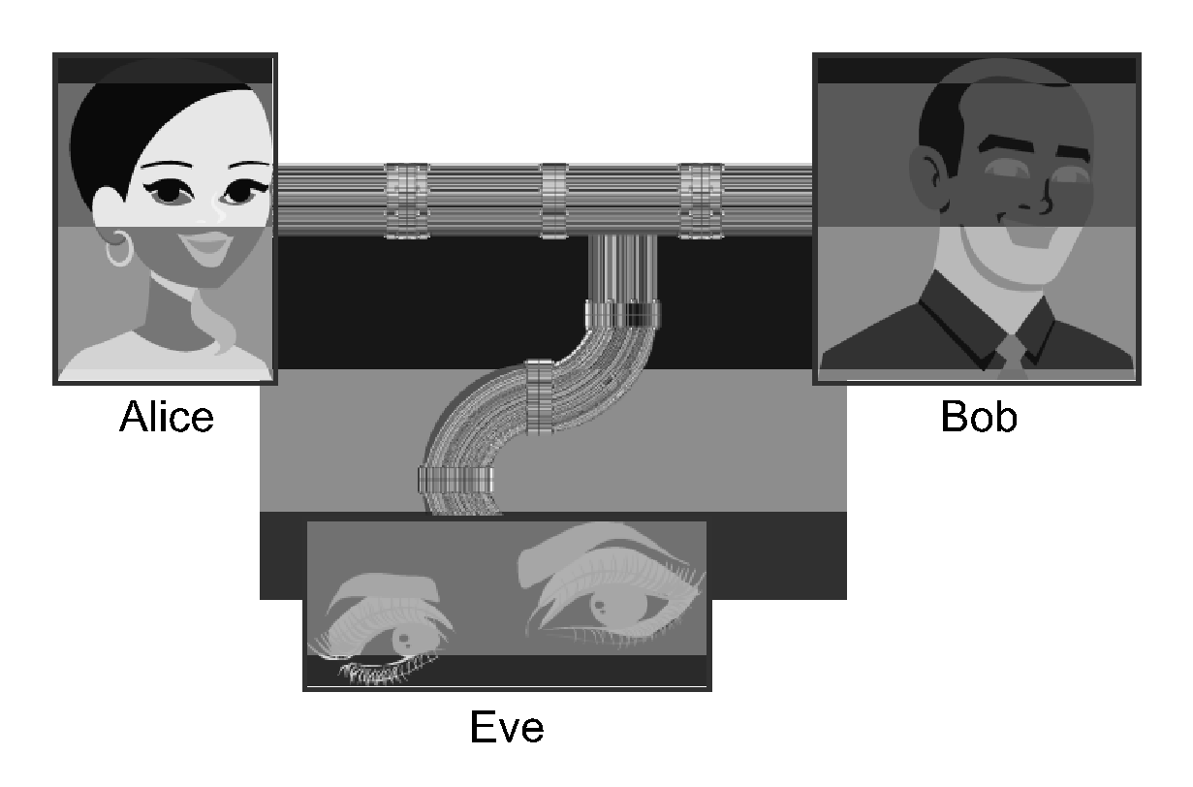
Crypto primitives
Alice wants to send a message (plaintext P) to Bob
The communication channel is insecure and can be eavesdropped by an attacker Eve
The goal is to allow secure exchanges of messages between Alice and Bob in an insecure channel
Crypto to the rescue!

Slide 4
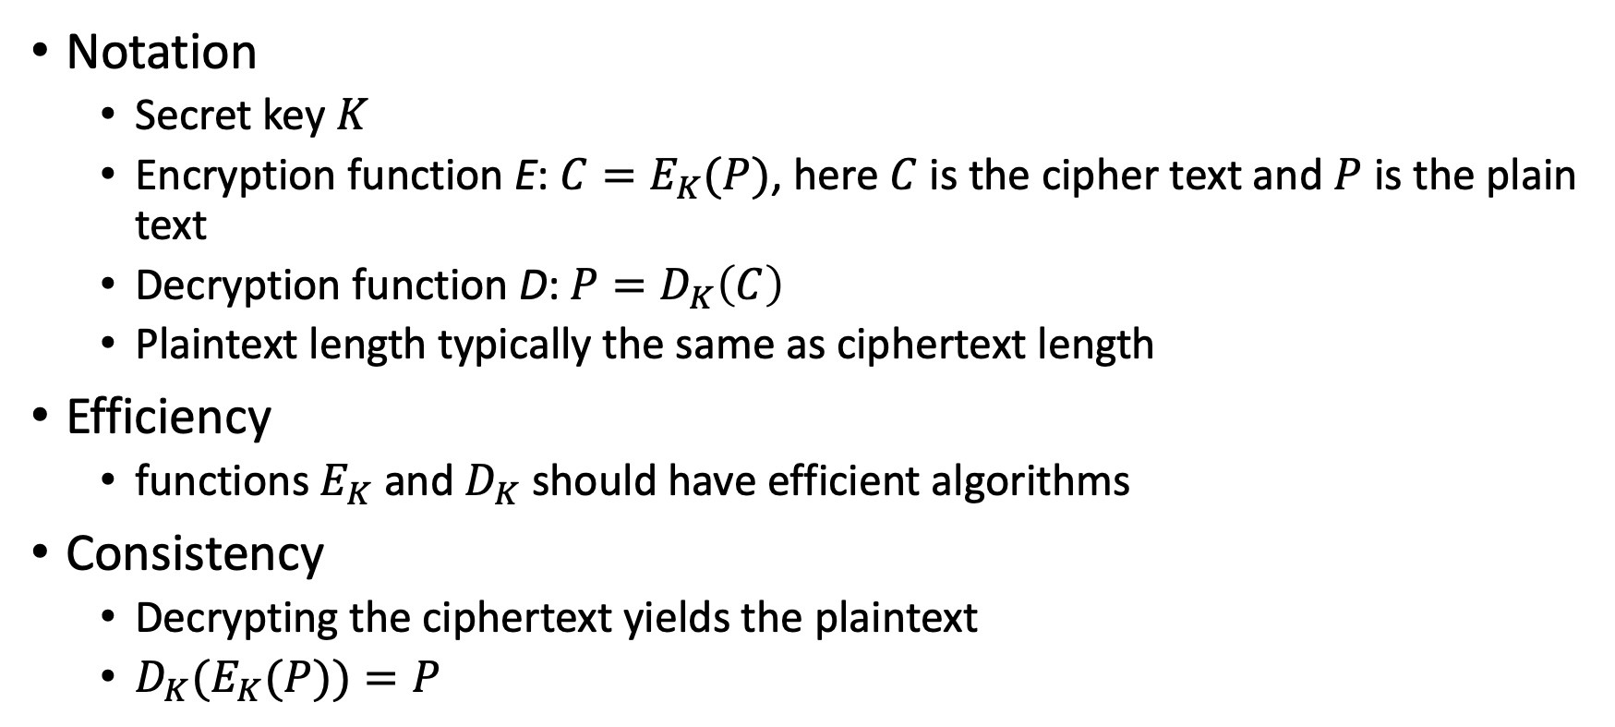
Crypto primitives

Slide 5
Cryptosystem attacks
The science of attacking cryptosystems is known as cryptanalysis and its practitioners are called cryptanalysts
In performing cryptanalysis, we assume that the cryptanalyst knows the algorithms for encryption and decryption
only the keys used are secret
This assumption follows the open design principle
The concept of achieving security by obscurity (e.g. a cryptanalyst does not know anything about algorithms) is likely to fail
This because such information might leak in different ways:
internal company documents could be published or stolen,
a programmer who coded an encryption algorithm could be bribed or could voluntarily disclose the algorithm, or
the software or hardware that implements an encryption algorithm could be reverse engineered

Slide 6
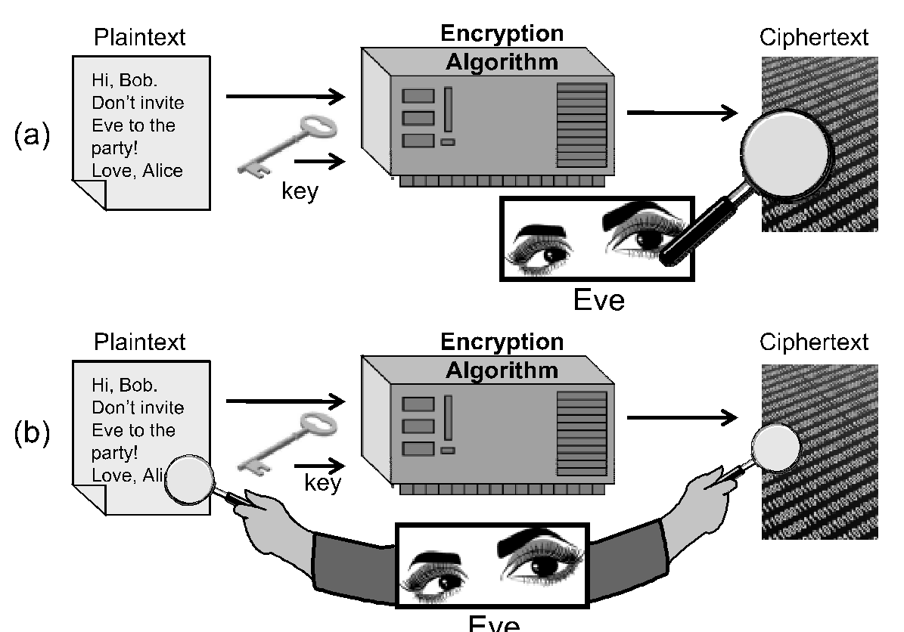
Cryptosystem attacks
Ciphertext-only attack
In this attack, the cryptanalyst has access to the ciphertext of one or more messages, all of which were encrypted using the same key, K
His or her goal is to determine the plaintext for one or more of these ciphertexts or, better yet, to discover K
Known-plaintext attack
In this attack, the cryptanalyst has access to one or more plaintext-ciphertext pairs, such that each plaintext was encrypted using the same key, K
His or her goal in this case is to determine the key, K

Slide 7
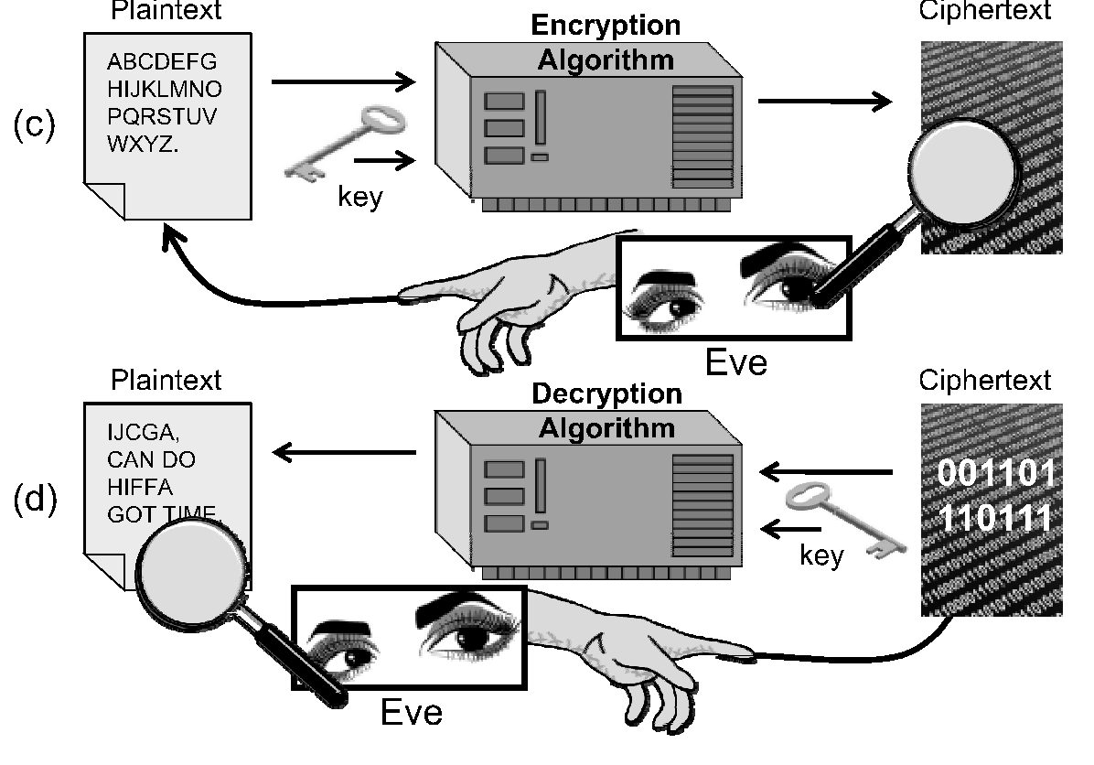
Cryptosystem attacks
Chosen-plaintext attack
In this attack, the cryptanalyst can chose one or more plaintext messages and get the ciphertext that is associated with each one, based on the use of same key, K
In the offline chosen-plaintext attack, the cryptanalyst must choose all the plaintexts in advance
In the adaptive chosen-plaintext attack, the cryptanalyst can choose plaintexts in an iterative fashion, where each plaintext choice can be based on information he gained from previous plaintext encryptions

Slide 8
Cryptosystem attacks
Chosen-ciphertext attack
In this attack, the cryptanalyst can choose one or more ciphertext messages and get the plaintext that is associated with each one, based on the use of same key, K
As with the chosen-plaintext attack, this attack also has both offline and adaptive versions

Slide 9
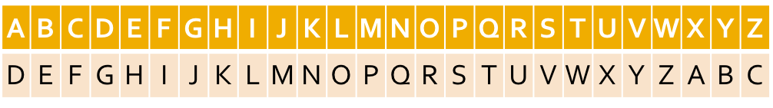
Classic cipher: Substitution cipher
Each letter is uniquely replaced by another
Caesar cipher is an example of a substitution cipher utilised by Julius Caesar:
Here, each letter in the plaintext is shifted three letters on right
When it reaches the end, it is wrapped back at the beginning
The decryption would require a three left shift
An example of a Caesar shift is given below:

Slide 10
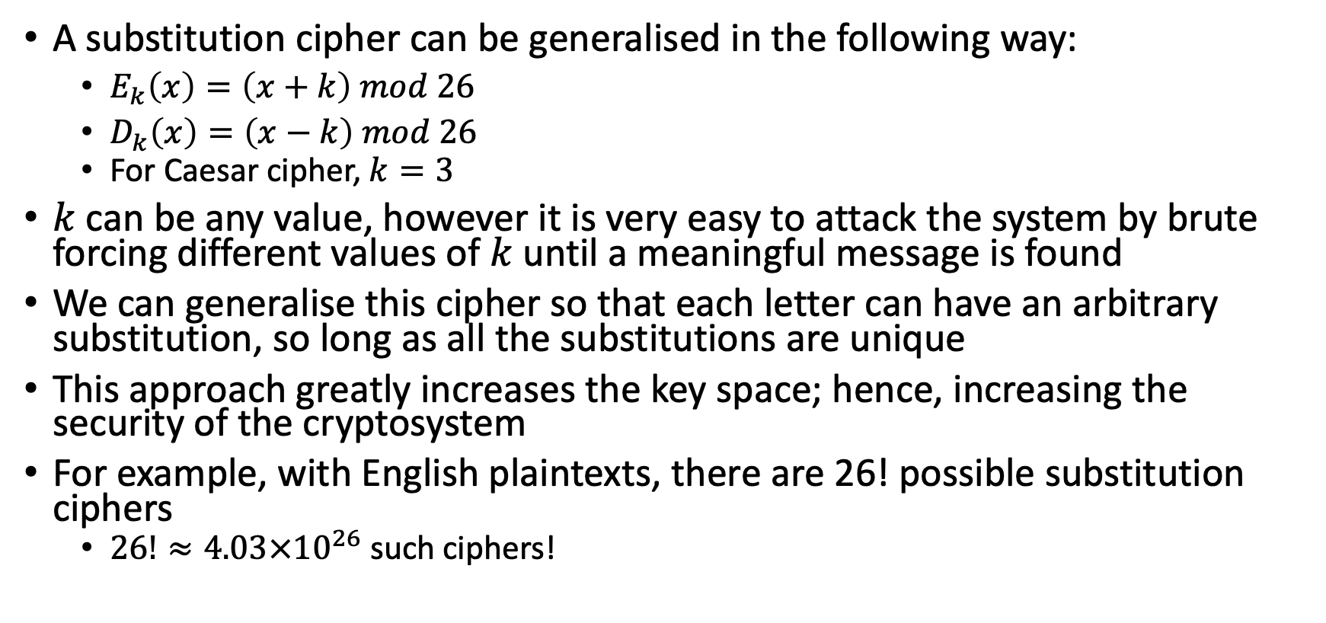
Classic cipher: Substitution cipher

Slide 11
Substitution cipher attack
Even with this huge key space, a substitution cipher can be easily broken
This is because letters in a natural language, like English, are not uniformly distributed
Knowledge of letter frequencies, including pairs and triples can be used in cryptologic attacks against substitution ciphers
For example, in English text, the letter “E” occurring just over 12% of the time, and “T” occurring less than 10% of the time
The most frequently occurring character in a ciphertext created from English substitution cipher probably corresponds to the letter E and so on

Slide 12
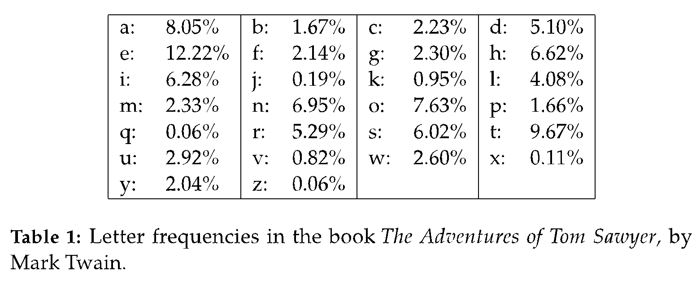
Substitution cipher attack

Slide 13
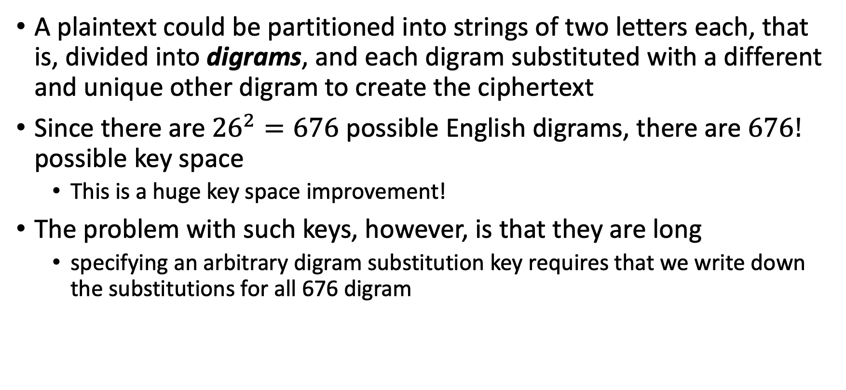
Polygraphic substitution cipher

Slide 14
Polygraphic substitution cipher
One easy way to express a digram substitution is using a two-dimensional table
In such a table, the first letter in a pair would specify a row, the second letter in a pair would specify a column, and each entry would be the unique two-letter substitution to use for this pair.
Such a specification is called a substitution box or S-box
This approach can be extended for binary values

Slide 15
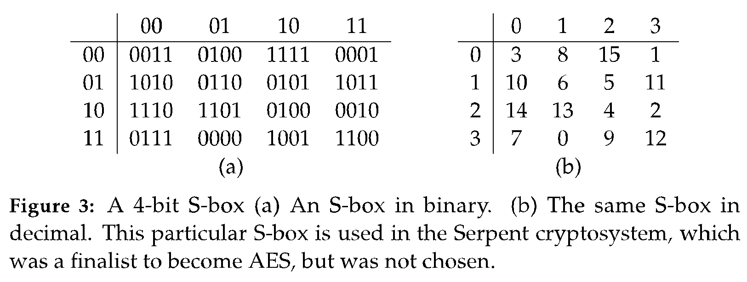
Polygraphic substitution cipher
This approach can be extended for binary values

Slide 16
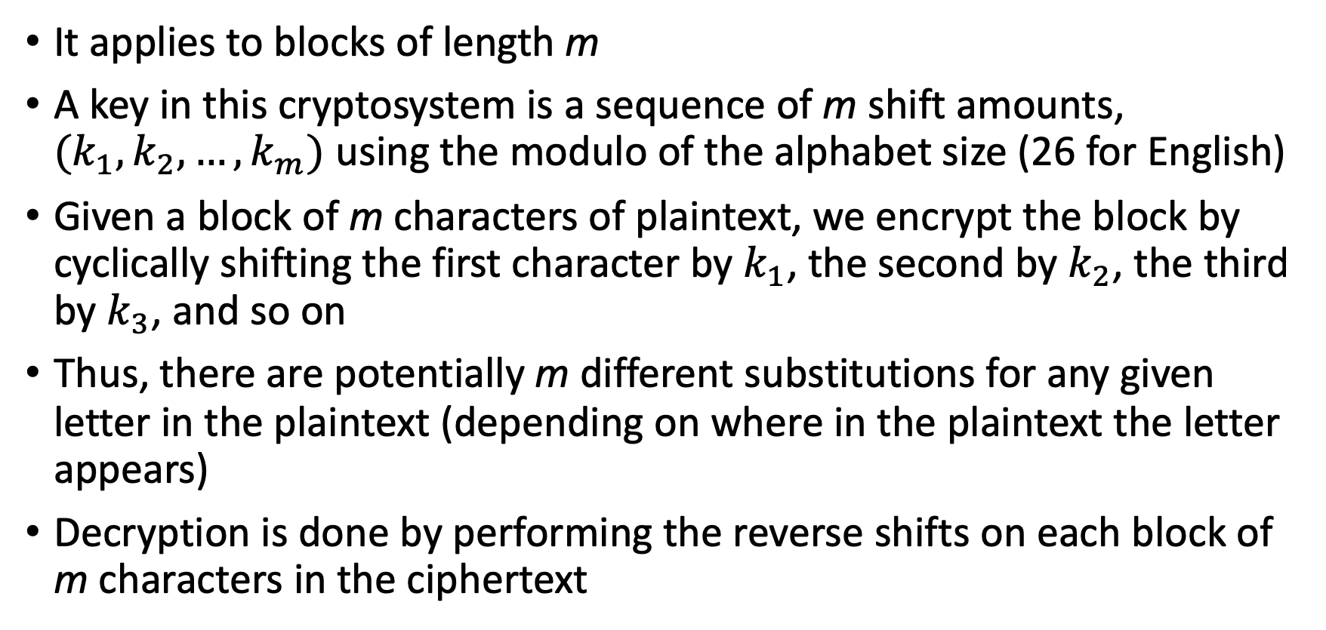
Classic cipher: Vigenère cipher

Slide 17
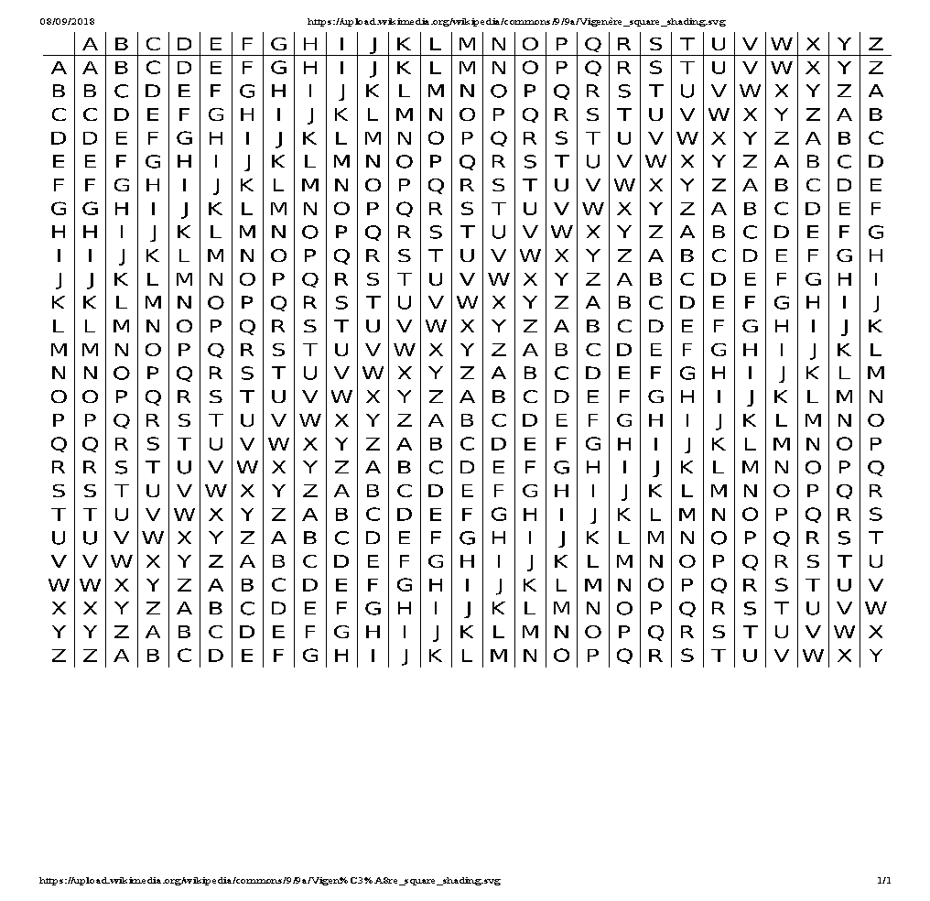
Vigenère cipher
Unfortunately, it can be easily broken using statistical techniques

Slide 18
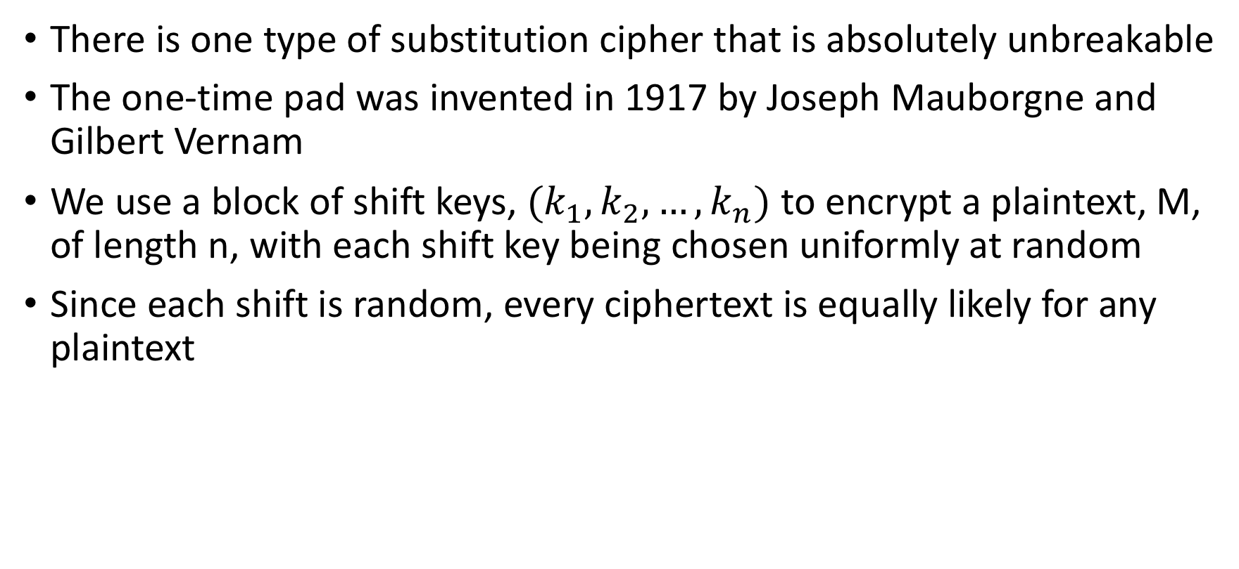
One-Time Pads

Slide 19
One-Time Pads
In spite of their perfect security, one-time pads have some weaknesses
The key has to be as long as the plaintext
Keys can never be reused
Repeated use of one-time pads allowed the U.S. to break some of the communications of Soviet spies during the Cold War

Slide 20
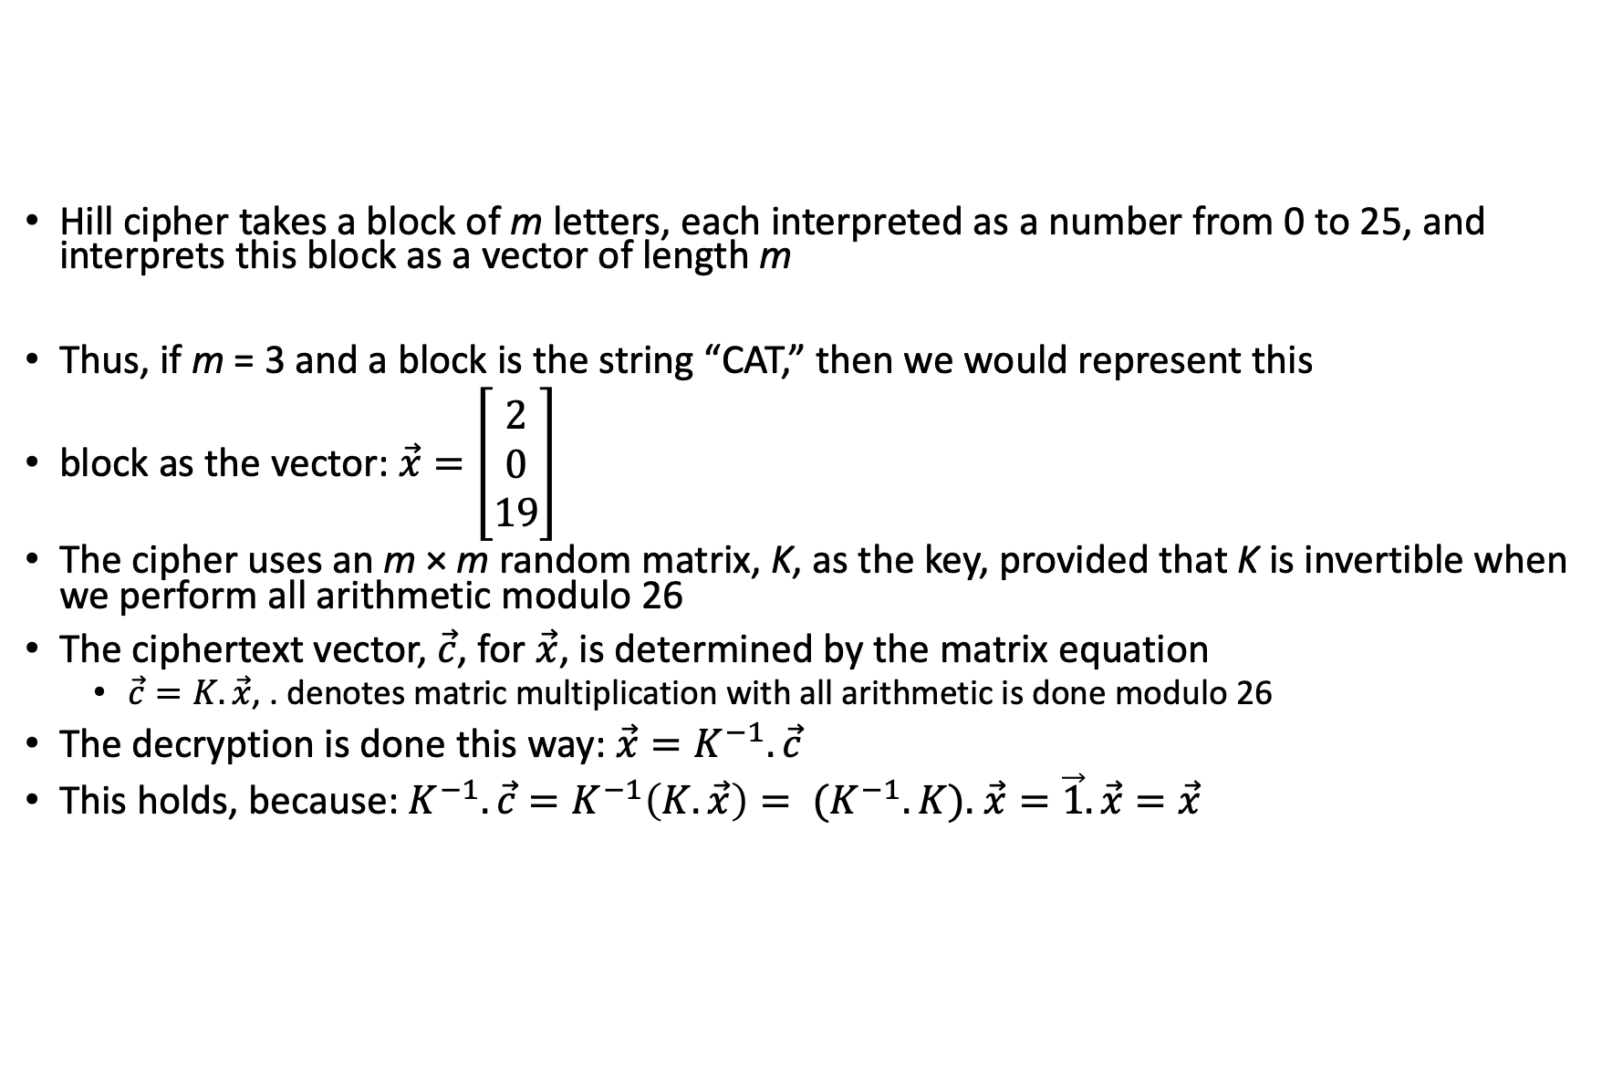
Classic cipher – Hill cipher

Slide 21
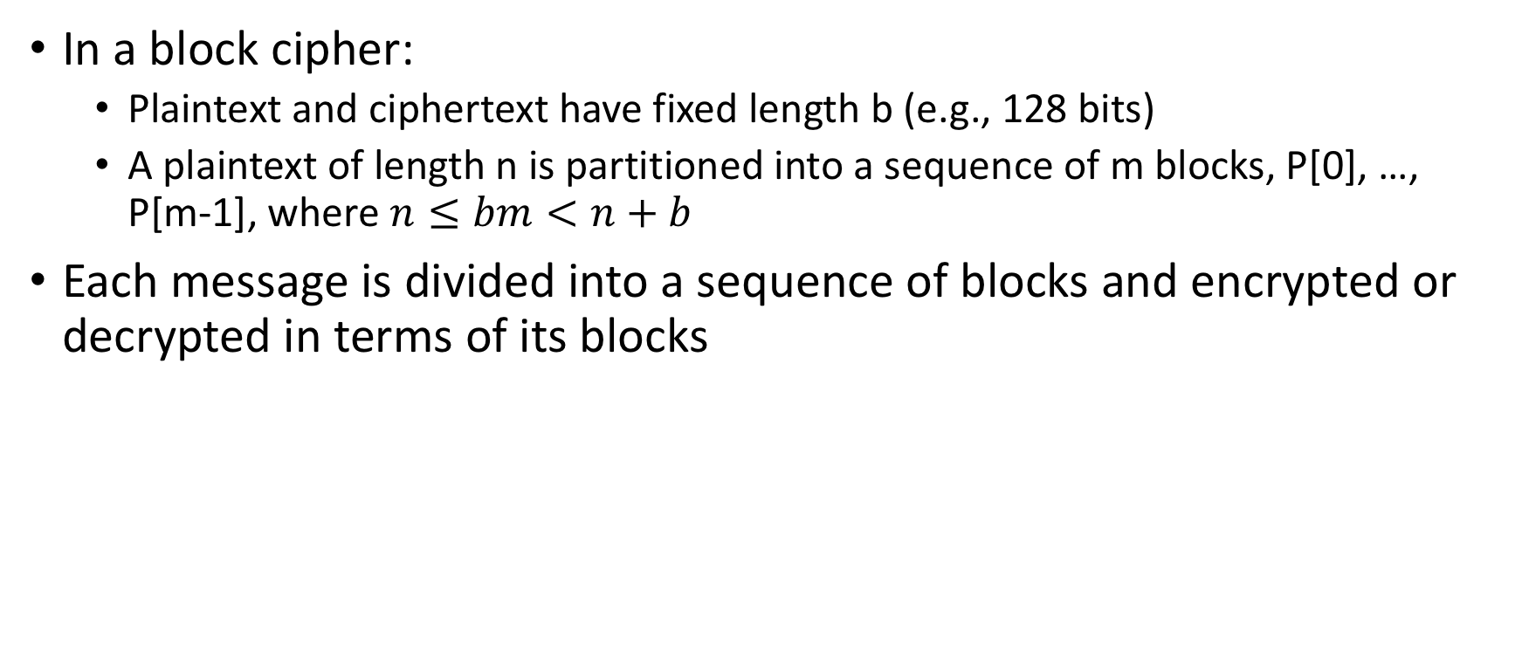
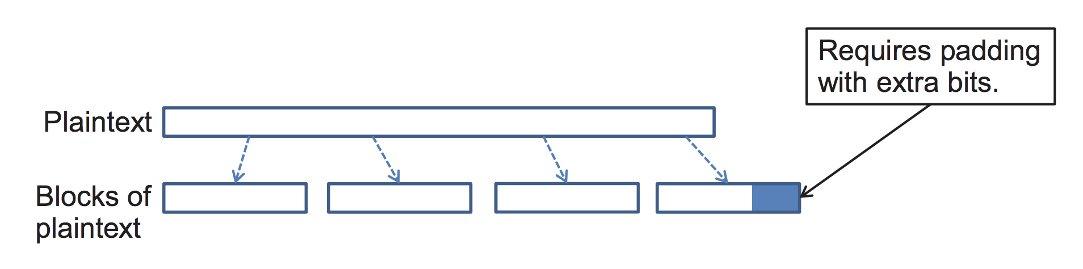
Block cipher

Slide 22
Padding
Block ciphers require the length n of the plaintext to be a multiple of the block size b
Padding the last block needs to be unambiguous (cannot just add zeroes)
When the block size and plaintext length are a multiple of 8, a common padding method (PKCS5) is a sequence of identical bytes, each indicating the length (in bytes) of the padding
Example for b = 128 (16 bytes)
Plaintext: “Roberto” (7 bytes)
Padded plaintext: “Roberto999999999” (16 bytes), where 9 denotes the number and not the character
We need to always pad the last block, which may consist only of padding
To remove any ambiguity if the message has a padding or not!

Slide 23
Modes of operation
There are several ways to use a block cipher, such as AES(Advanced Encryption Standard) , that operate on fixed-length blocks
The different ways such an encryption algorithm can be used are known as its modes of operation
Four modes of operation:
Electronic Codebook (ECB) Mode
Cipher-Block Chaining (CBC) Mode
Cipher Feedback (CFB) Mode
Output Feedback (OFB) Mode
Notes:
A

Slide 24
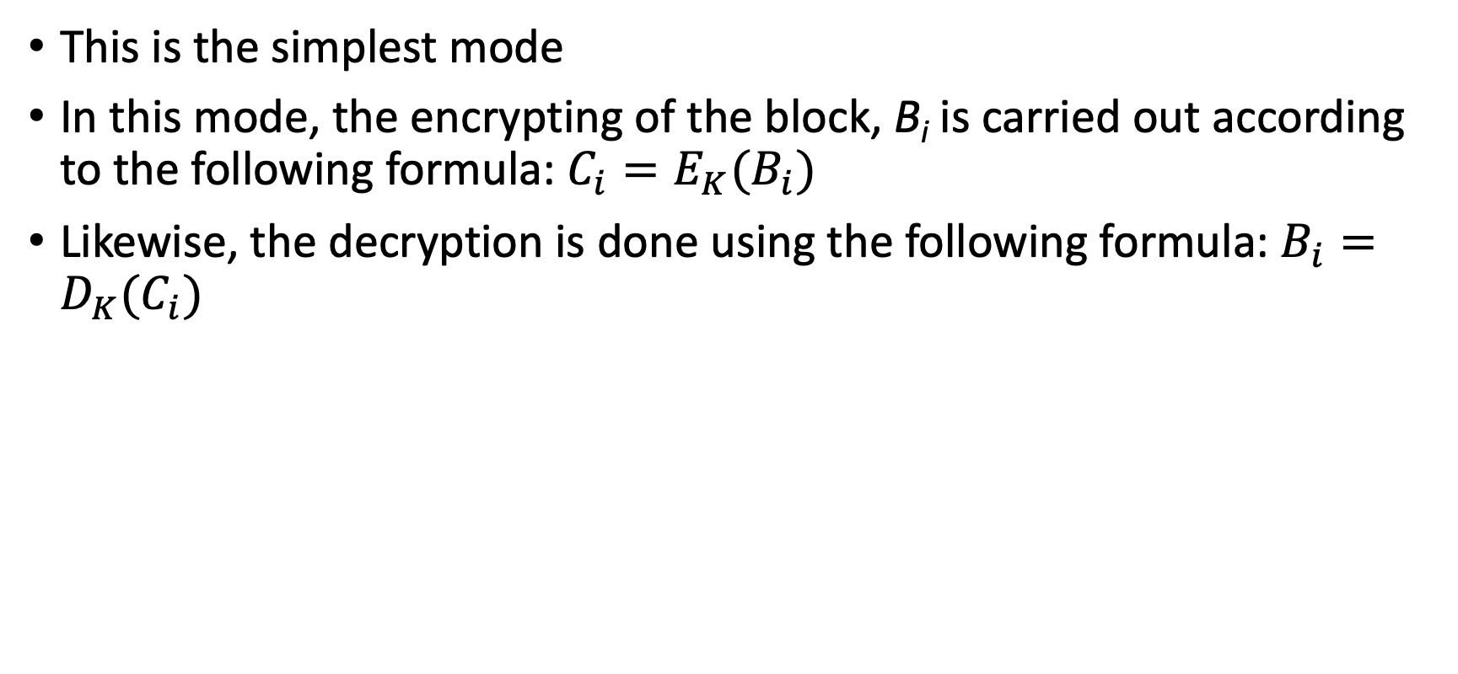
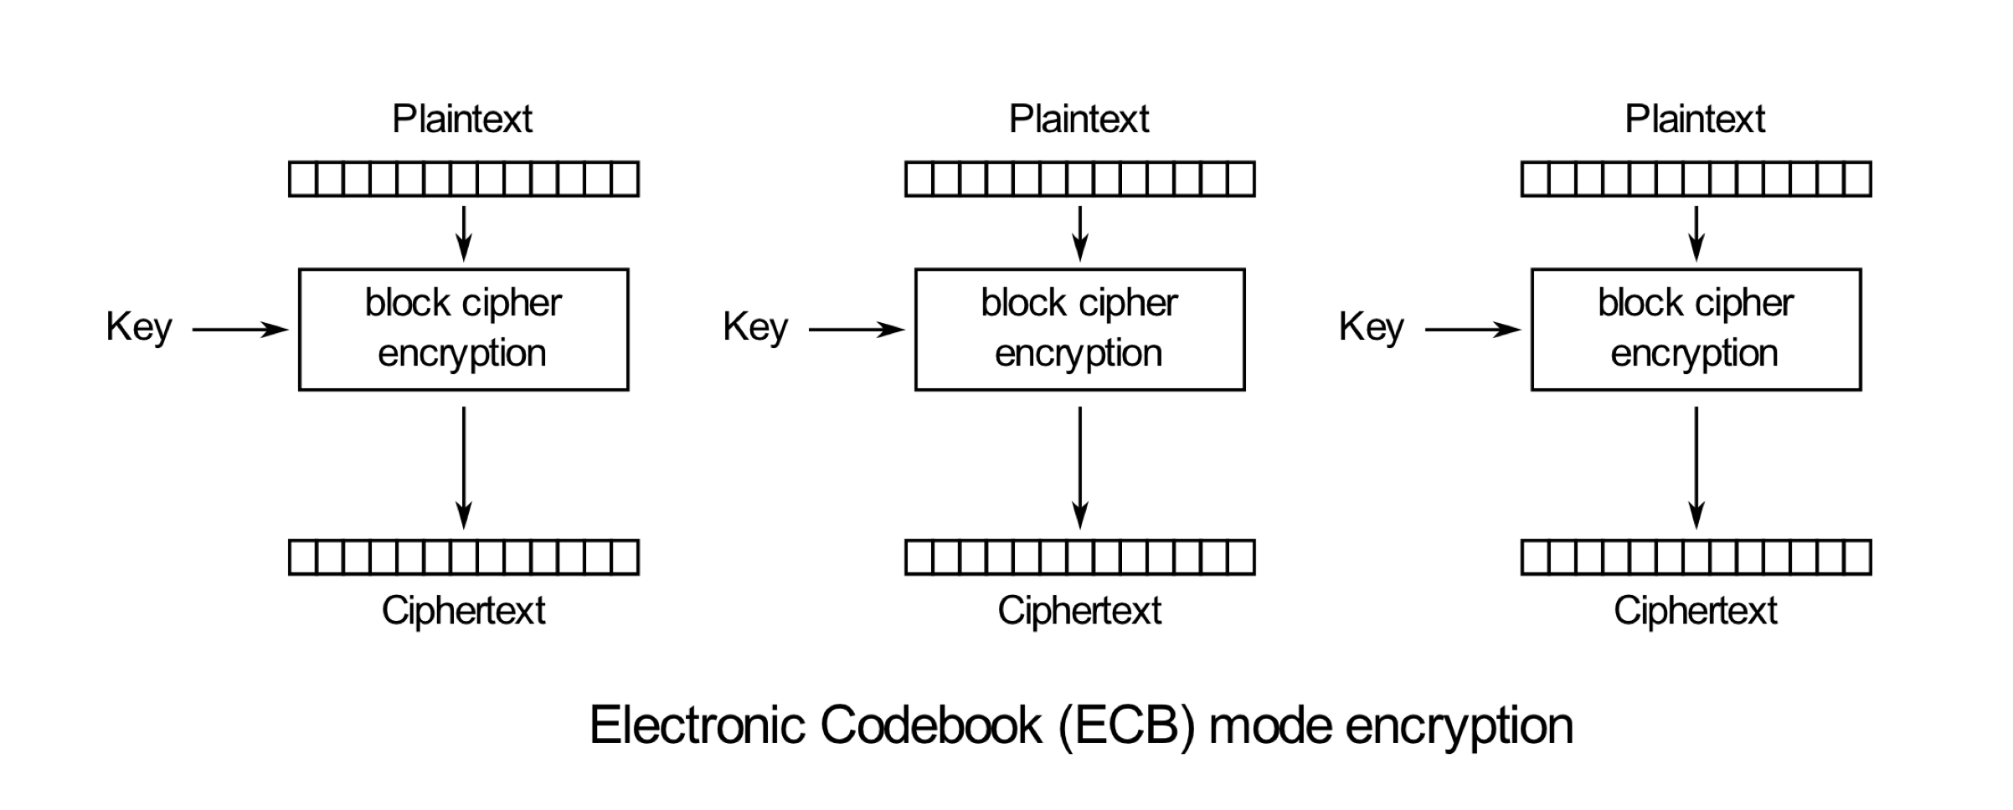
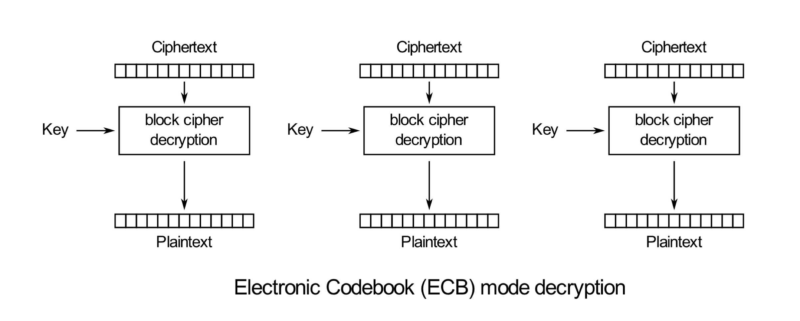
Electronic Codebook (ECB) Mode
Source: https://en.wikipedia.org/wiki/Block_cipher_mode_of_operation

Slide 25
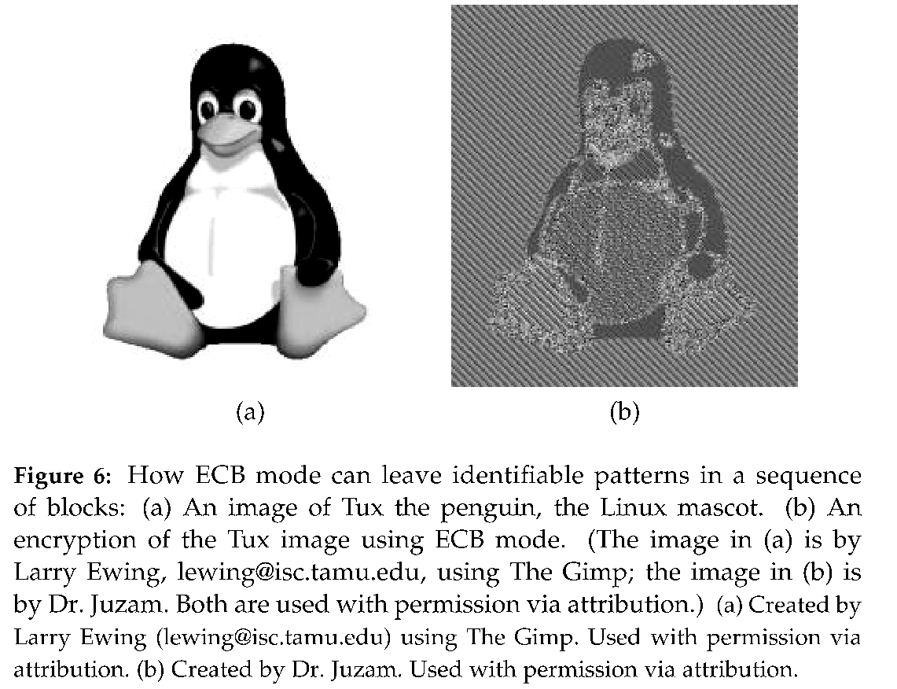
Electronic Codebook (ECB) Mode: pros & cons
ECB mode works well with random strings (e.g., keys and initialization vectors) and strings that fit in one block
Documents and images are not suitable for ECB encryption since patters in the plaintext are repeated in the ciphertext
Example of image encrypted in ECB :

Slide 26
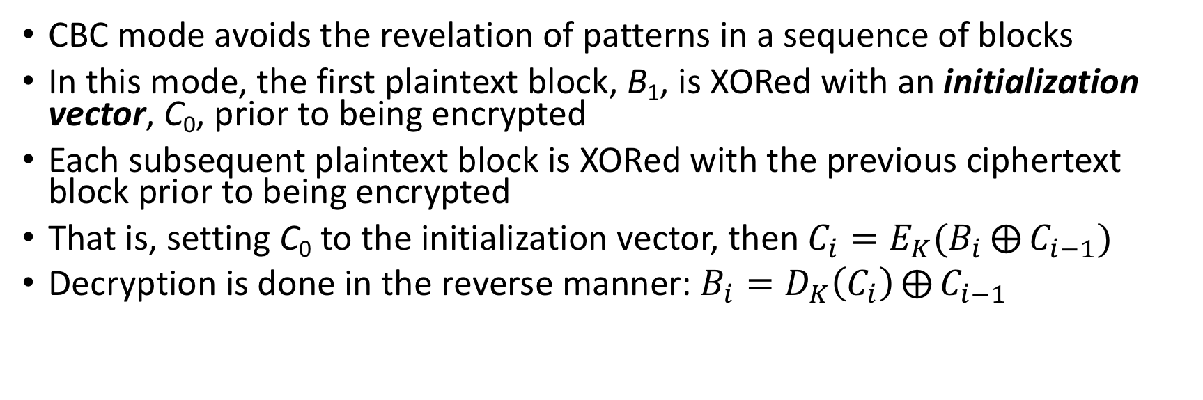
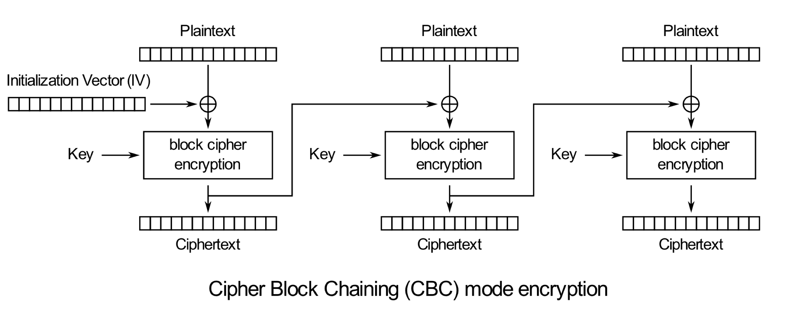
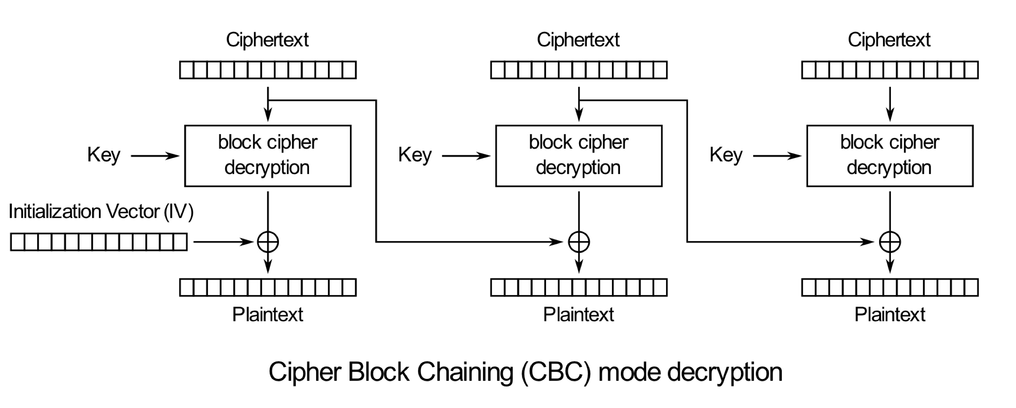
Cipher–block Chaining (CBC) Mode
Source: https://en.wikipedia.org/wiki/Block_cipher_mode_of_operation

Slide 27
CBC Mode: pros & cons
Strengths:
Doesn’t show patterns in the plaintext
Is the most common mode
Is fast and relatively simple
Weaknesses:
CBC requires the reliable transmission of all the blocks sequentially
CBC is not suitable for applications that allow packet losses (e.g., music and video streaming)

Slide 28
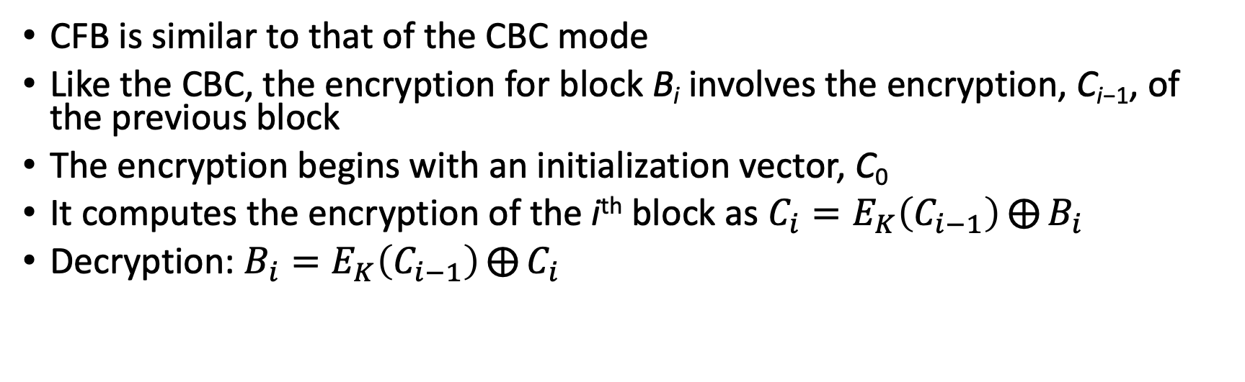
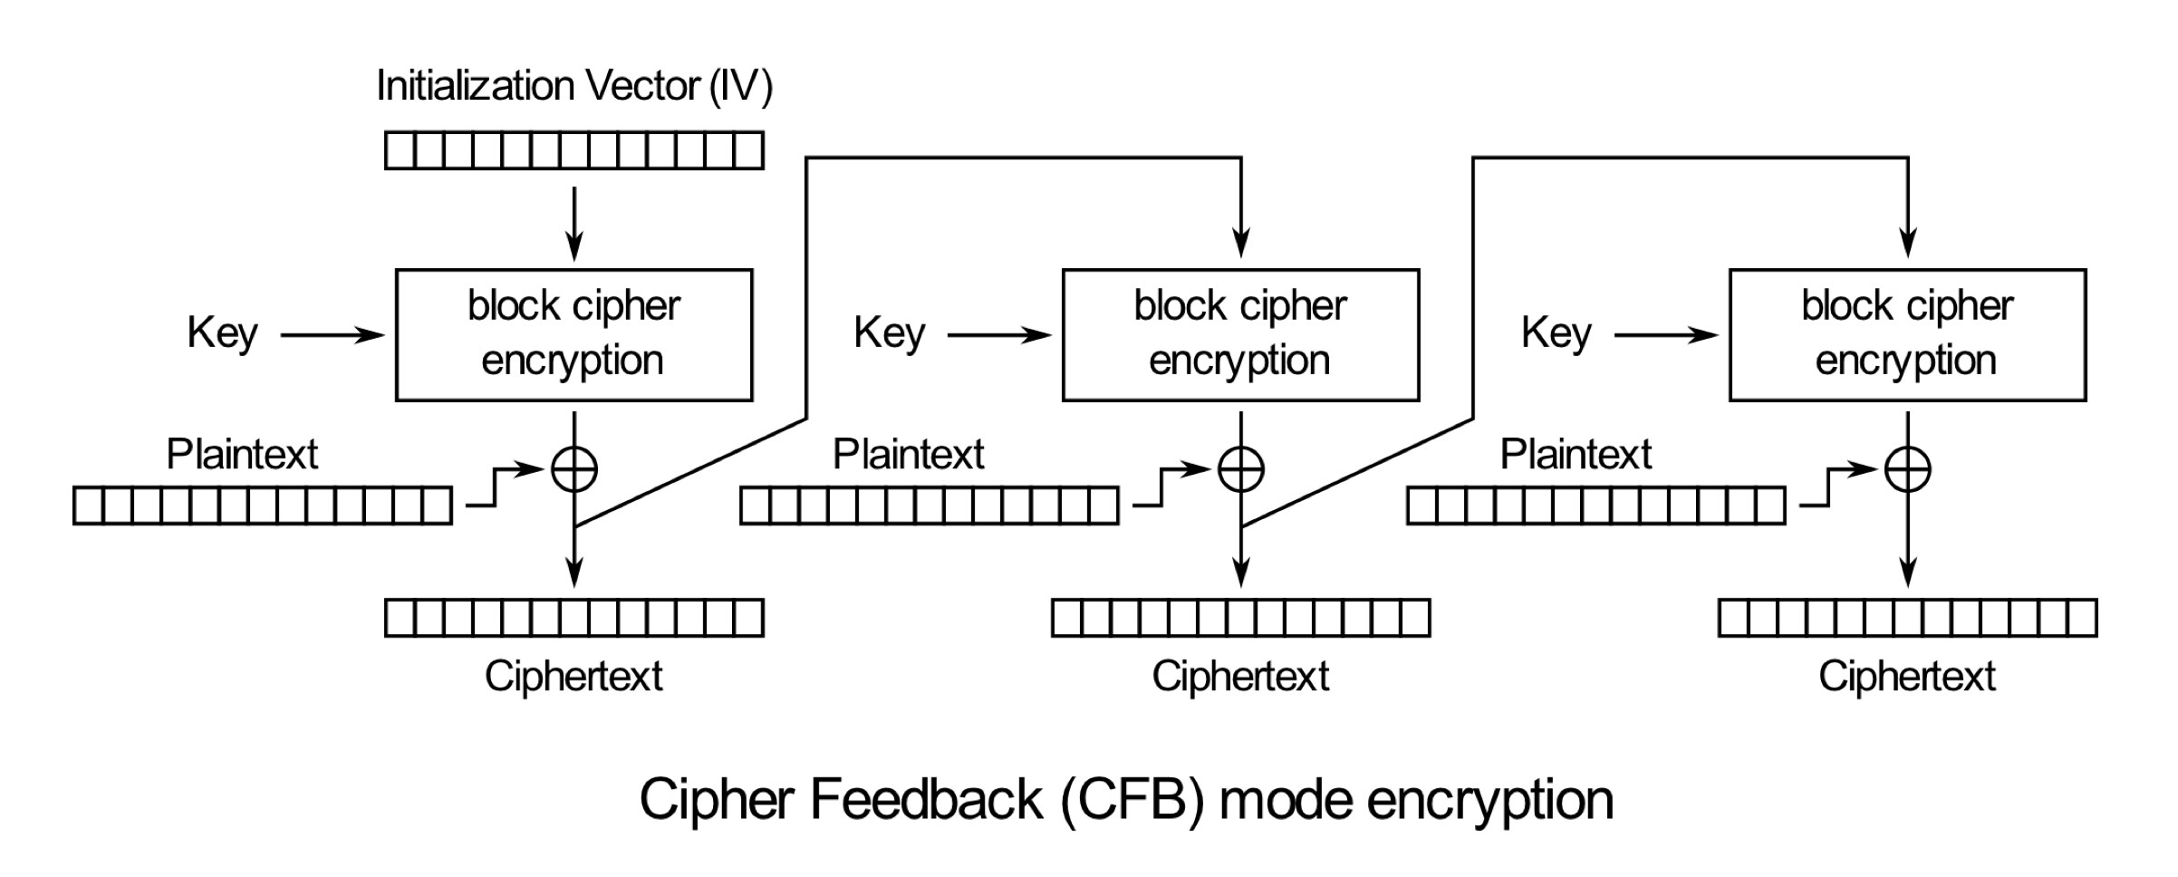
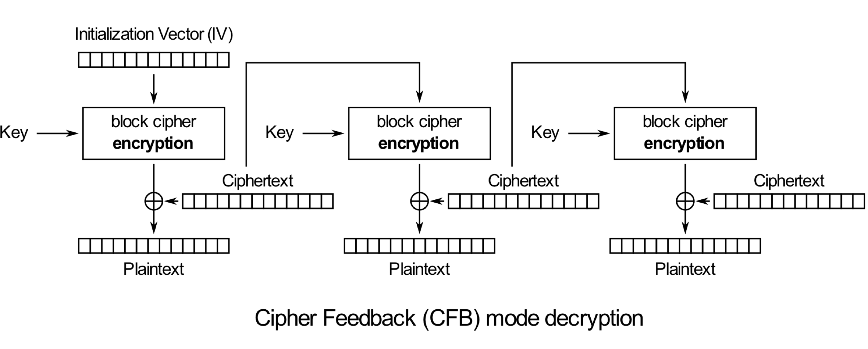
Cipher Feedback (CFB) Mode
Source: https://en.wikipedia.org/wiki/Block_cipher_mode_of_operation

Slide 29
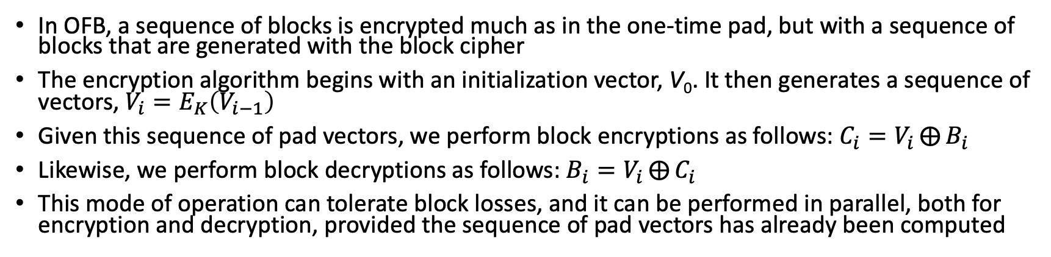
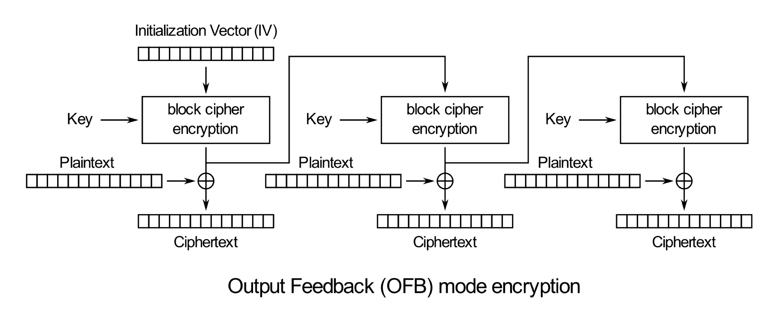
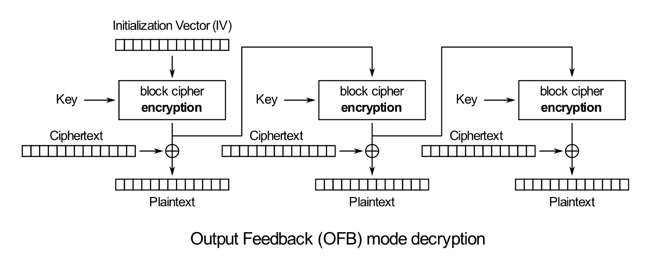
Output Feedback (OFB) Mode
Source: https://en.wikipedia.org/wiki/Block_cipher_mode_of_operation

Slide 30


